Slide 1
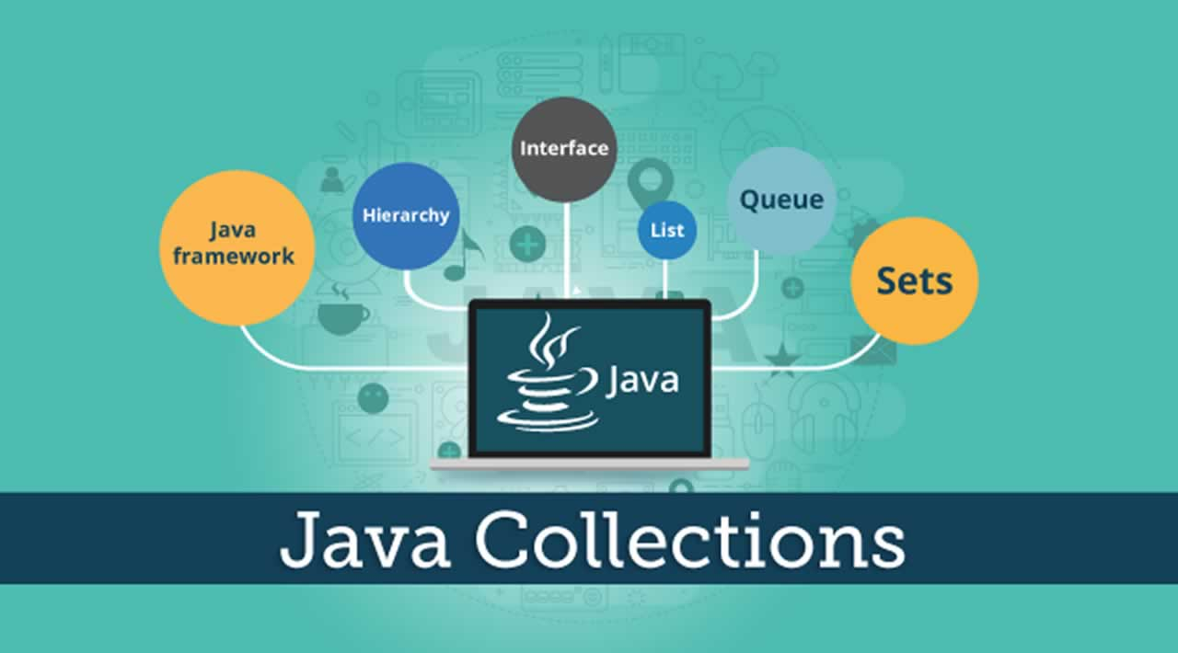

Slide 2
Collection in Java
The Collection in Java is a framework that provides an architecture to store and manipulate the group of objects.
Any group of individual objects which are represented as a single unit is known as the collection. In Java, a separate framework named the “Collection Framework” has been defined in JDK 1.2 which holds all the collection classes and interface in it.
The Collection interface (java.util.Collection) and Map interface (java.util.Map) are the two main “root” interfaces of Java collection classes.

Slide 3
Collection Framework
What is a Framework?
A framework is a set of classes and interfaces which provide a ready-made architecture. In order to implement a new feature or a class, there is no need to define a framework.
What is a Java Collection Framework?
A Java collection framework provides an architecture to store and manipulate a group of objects. A Java collection framework includes the following:
Interfaces
Classes

Slide 4
List Interface
List interface is the child interface of Collection interface. It inhibits a list type data structure in which we can store the ordered collection of objects. It can have duplicate values.
List interface is implemented by the classes ArrayList, LinkedList, Vector, and Stack.
To instantiate the List interface, we must use :
List <data-type> list1= new ArrayList();
List <data-type> list2 = new LinkedList();

Slide 5
ArrayList
Java ArrayList class uses a dynamic array for storing the elements. It is like an array, but there is no size limit. We can add or remove elements anytime. So, it is much more flexible than the traditional array. It is found in the java.util package.
The ArrayList in Java can have the duplicate elements also. It implements the List interface so we can use all the methods of the List interface here. The ArrayList maintains the insertion order internally.
The important points about the Java ArrayList class are:
Java ArrayList class can contain duplicate elements.
Java ArrayList class maintains insertion order.
In Java ArrayList class we can use get and set methods
Java ArrayList allows random access because the array works on an index basis.

Slide 6

ArrayList
import java.util.*;
class TestJavaCollection1{
public static void main(String args[]){
ArrayList<String> list=new ArrayList<String>();//Creating arraylist
list.add("Ravi");//Adding object in arraylist
list.add("Vijay");
list.add("Ravi");
list.add("Ajay");
list.remove(1); // To remove the value
}
}

Slide 7
Java Non-generic Vs. Generic Collection
Java collection framework was non-generic before JDK 1.5. Since 1.5, it is generic.
Java new generic collection allows you to have only one type of object in a collection. Now it is type-safe, so typecasting is not required at runtime.
ArrayList list=new ArrayList(); //creating non-generic arraylist
ArrayList<String> list=new ArrayList<String>(); //creating generic arraylist
In a generic collection, we specify the type in angular braces. Now ArrayList is forced to have the only specified type of object in it. If you try to add another type of object, it gives a compile-time error.

Slide 8
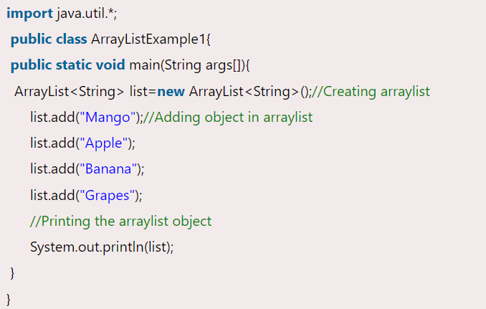


Slide 9
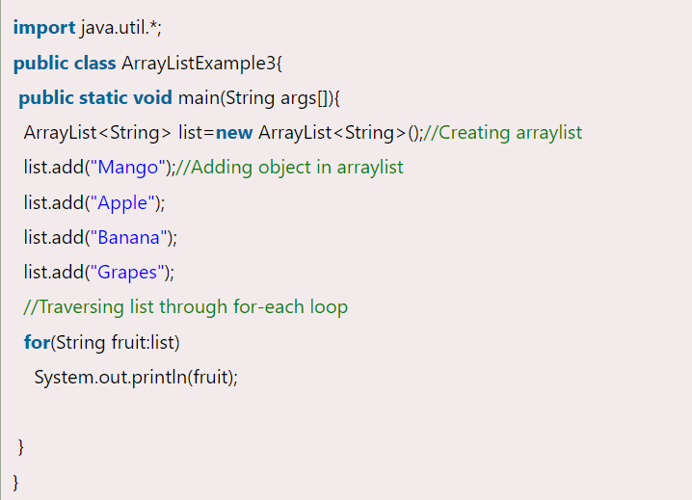

Iterating ArrayList using For-each loop

Slide 10
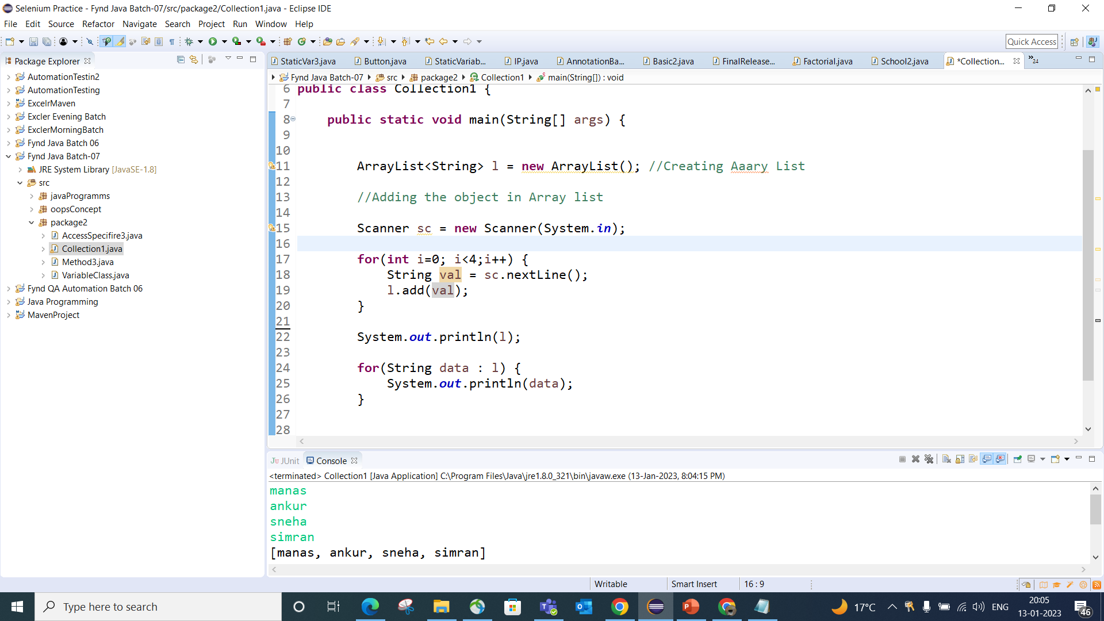

Slide 11
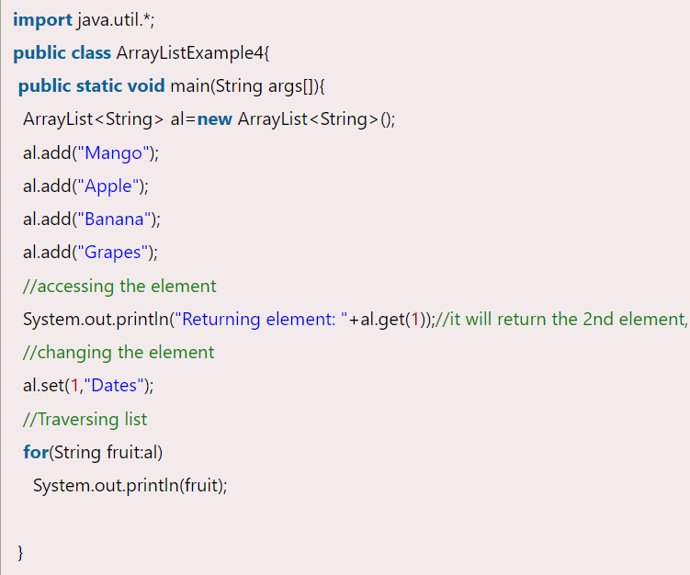
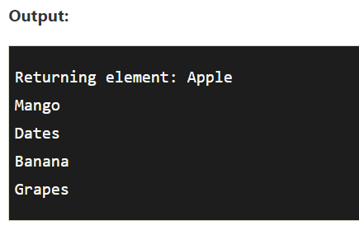
Get and Set ArrayList
The get() method returns the element at the specified index, whereas the set() method changes the element.

Slide 12
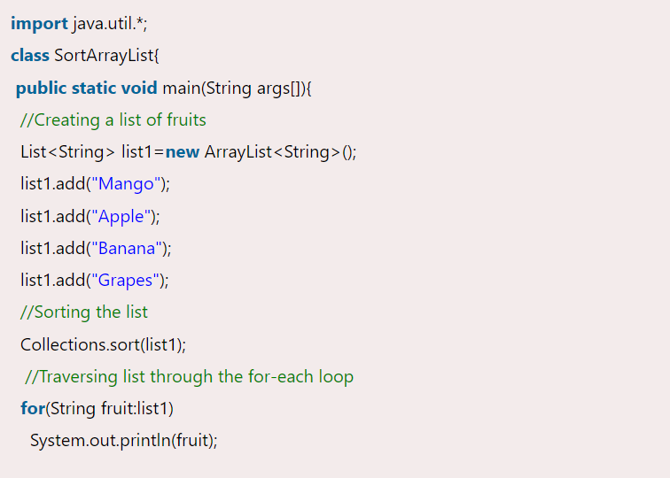

How to Sort ArrayList
The java.util package provides a utility class Collections, which has the static method sort(). Using the Collections.sort() method, we can easily sort the ArrayList.

Slide 13
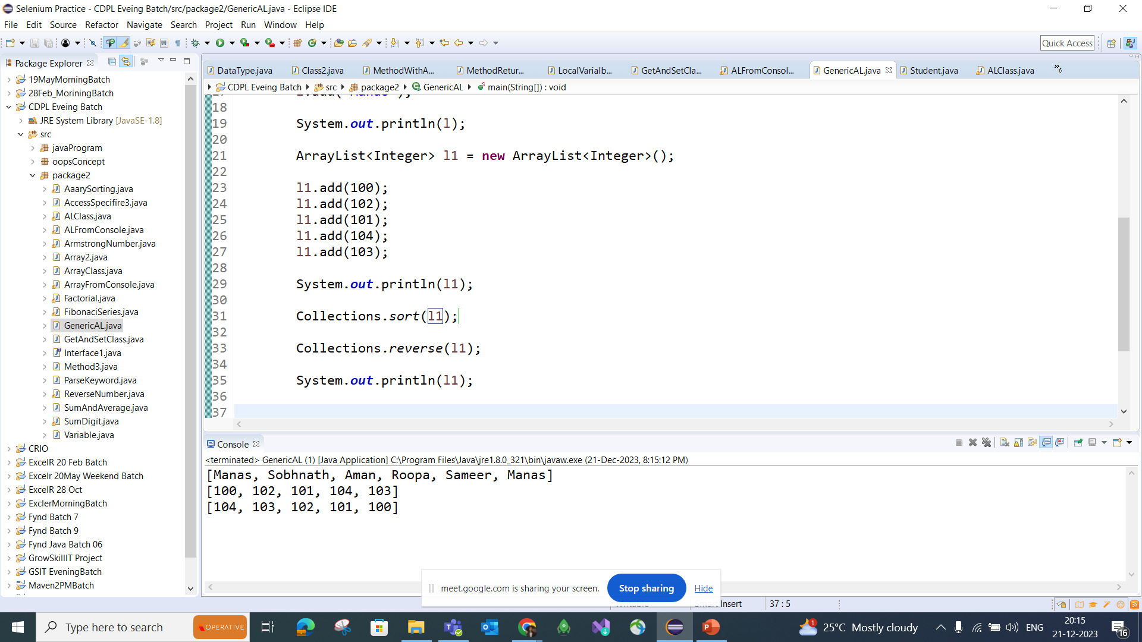
Sorting and Reverse of Array List

Slide 14
Set Interface
Set Interface in Java is present in java.util package. It extends the Collection interface. It represents the unordered set of elements which doesn't allow us to store the duplicate items. We can store at most one null value in Set. Set is implemented by HashSet, LinkedHashSet, and TreeSet class.
Set<data-type> s1 = new HashSet<data-type>();

Slide 15
HashSet
HashSet class implements Set Interface. It represents the collection that uses a hash table for storage. Hashing is used to store the elements in the HashSet. It contains unique items.
The important points about Java HashSet class are:
HashSet stores the elements by using a mechanism called hashing.
HashSet contains unique elements only.
HashSet allows null value.
HashSet class is non synchronized.
HashSet doesn't maintain the insertion order. Here, elements are inserted on the basis of their hashcode.

Slide 16
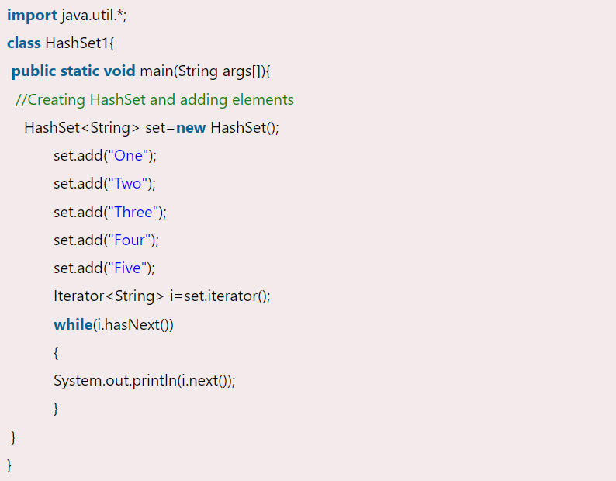
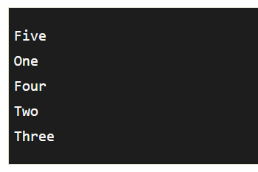
Java HashSet Example

Slide 17

Java HashSet example ignoring duplicate elements
import java.util.*;
public class TestJavaCollection7{
public static void main(String args[]){
//Creating HashSet and adding elements
HashSet<String> set=new HashSet<String>();
set.add("Ravi");
set.add("Vijay");
set.add("Ravi");
set.add("Ajay");
//Traversing elements
Iterator<String> itr=set.iterator();
while(itr.hasNext()){
System.out.println(itr.next());
} } }

Slide 18
Java Map Interface
A map contains values on the basis of key, i.e. key and value pair. Each key and value pair is known as an entry. A Map contains unique keys.
A Map is useful if you have to search, update or delete elements on the basis of a key.
HashMap class Parameters
K: It is the type of keys maintained by this map.
V: It is the type of mapped values.
Points to remember
Java HashMap contains values based on the key.
Java HashMap contains only unique keys.
Java HashMap may have one null key and multiple null values.
Java HashMap is non synchronized.
Java HashMap maintains no insertion order.

Slide 19
Java HashMap
Java HashMap class implements the Map interface which allows us to store key and value pair, where keys should be unique. If you try to insert the duplicate key, it will replace the element of the corresponding key. It is easy to perform operations using the key index like updation, deletion, etc. HashMap class is found in the java.util package.
HashMap in Java is like the legacy Hashtable class, but it is not synchronized. It allows us to store the null elements as well, but there should be only one null key. Since Java 5, it is denoted as HashMap<K,V>, where K stands for key and V for value. It inherits the AbstractMap class and implements the Map interface.

Slide 20
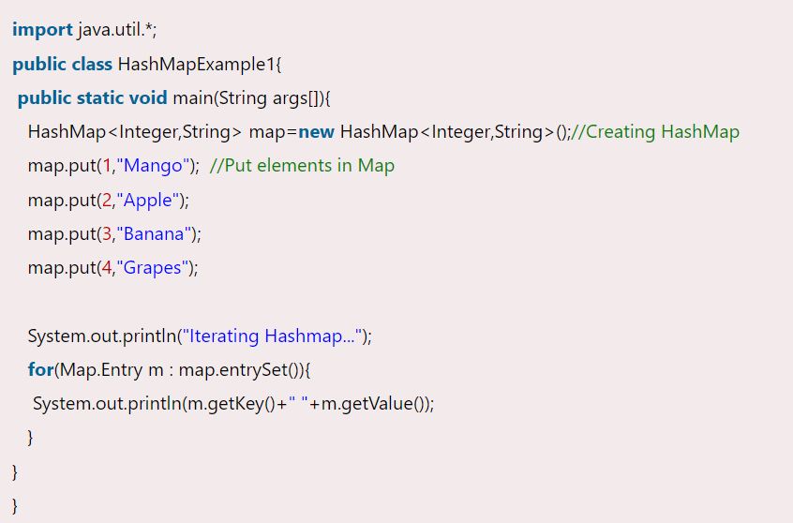
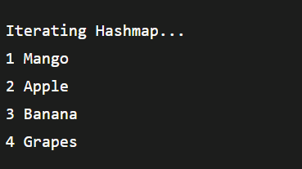
Java HashMap Example

Slide 21
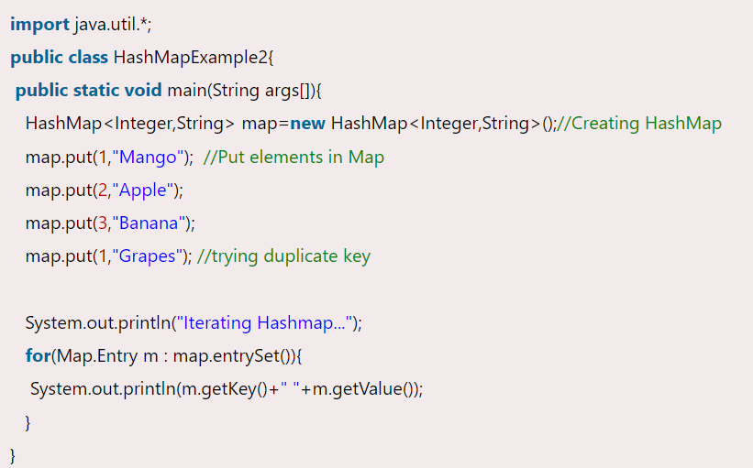
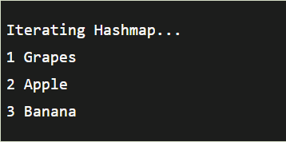
No Duplicate Key on HashMap
You cannot store duplicate keys in HashMap. However, if you try to store duplicate key with another value, it will replace the latest value.

Slide 22
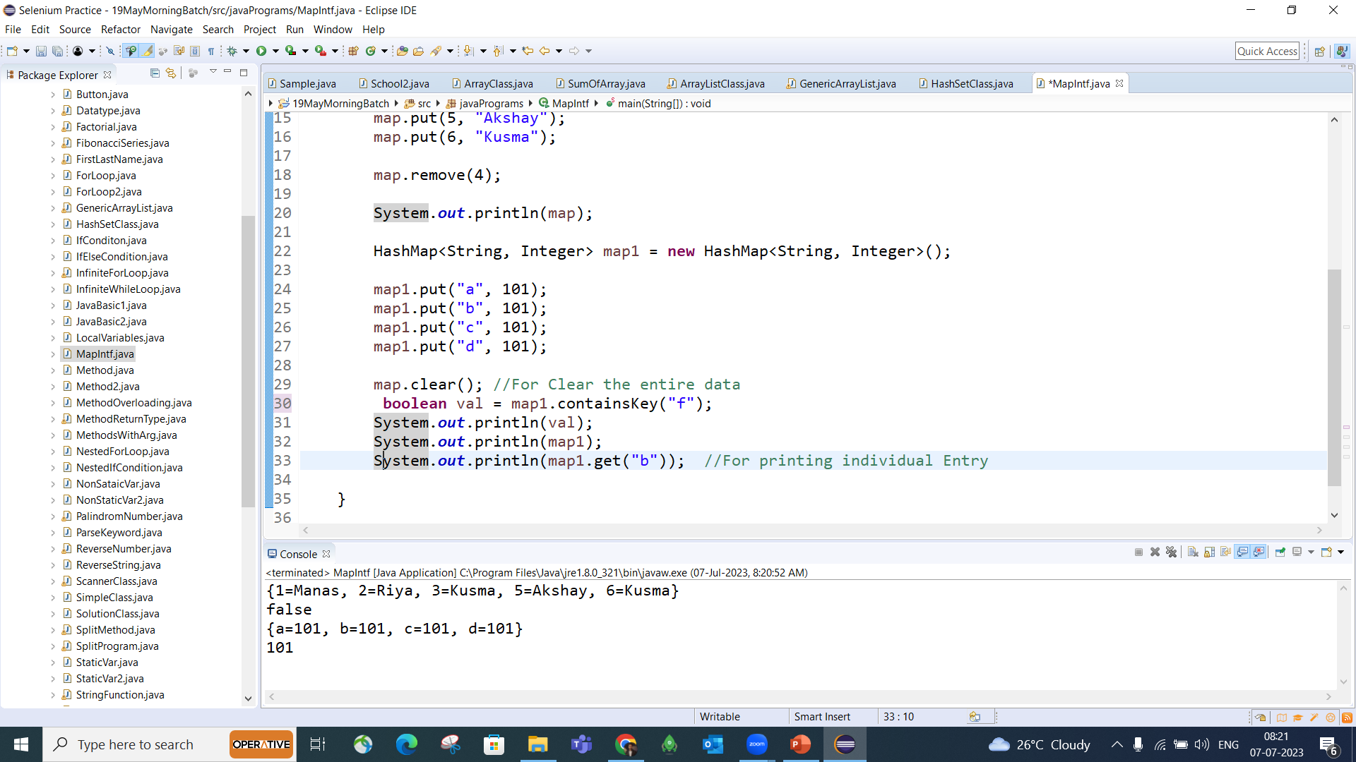

Slide 23
Difference between HashSet and HashMap:
HashSet contains only values whereas HashMap contains an entry(key and value).

Slide 24
Difference between Array and Collection in java
Parameter | Array | Collection
1) Size | Array is fixed in size | Collection is dynamic in size
2) Data | Array can store only homogeneous data only | Collection can store homogeneous as well as hetrogeneous data
3) Data Storage | Array can store primtive as well as objects | Collections stores only object
4) Data Structure | Array does not have any standard data structure so no ready-made methods available | Collection supports standard data structure so ready-made methods are available
5) Memory | Memory wise array is worst choice | Memory wise collection is best choice
6) Performance | Performance wise array is good choice | Performance wise collection is worst choice

